Slide 1
Conflict and Negotiation

Slide 2
Conflict
Conflict is a process that begins when one party perceives that another party has negatively affected, or is about to negatively affect, something that the first party values
LECTURE 10: Conflict ∙ Conflict Management ∙ Negotiation

Slide 3
Conflict
Functional conflict is constructive and cooperative, it is characterized by consultative interaction, a focus on the issues, mutual respect, and useful give-and-take; it may involve challenging ideas, standards, or processes that are ineffective
Dysfunctional conflict places the focus on the conflict, rather than the interests of the organization; it is often personal, involving aggression or threats directed at specific people
When conflict gets personal – directed at people not ideas
LECTURE 10: Conflict ∙ Conflict Management ∙ Negotiation

Slide 4
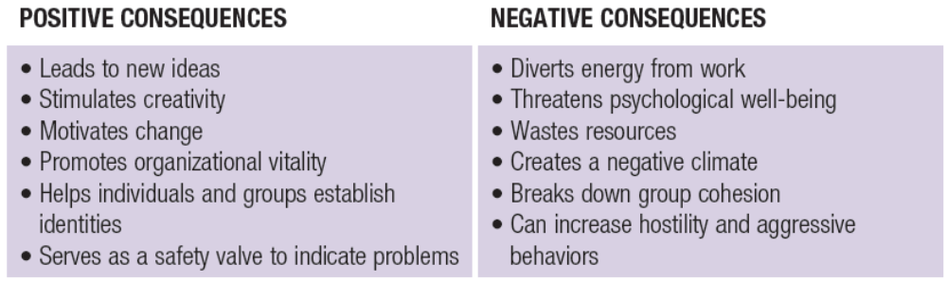
Conflict
Outcomes of functional and dysfunctional conflict:
Functional conflict doesn’t just resolve the issue, it builds the capacity to keep future conflicts functional **Key point**
LECTURE 10: Conflict ∙ Conflict Management ∙ Negotiation

Slide 5
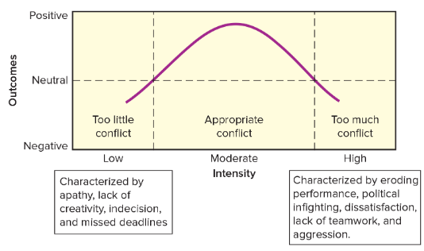
Conflict
LECTURE 10: Conflict ∙ Conflict Management ∙ Negotiation

Slide 6
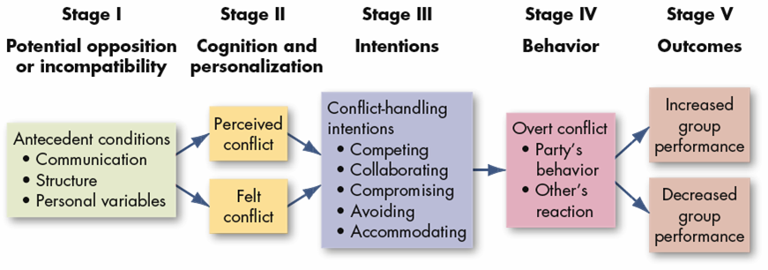
Conflict
Conflict is a process:
LECTURE 10: Conflict ∙ Conflict Management ∙ Negotiation
Notes:
Three forms of conflict:
Interorganizational (between organizations)
Intergroup (between groups)
Can increase cohesion, loyalty, and task focus within group; become hostile, less communication
Intragroup (within a group)
Avoid groupthink; in-fighting or side-taking

Slide 7
Causes of Conflict
Structural factors: (situation of role things put on you due to the structure around you)
Specialization (of tasks or rules)
Interdependence (requires cooperation)
Common resources (major issue)
Goal differences
Authority relationships (leader style matters)
Status inconsistencies
Jurisdictional ambiguities
Role conflict
LECTURE 10: Conflict ∙ Conflict Management ∙ Negotiation

Slide 8
Causes of Conflict
A common structural source is role conflict, in which expectations for how to act in one’s role come from many sources that conflict with one another:
  Interrole: Conflict between multiple roles
  Intrarole: Conflict from multiple senders to one role (two people telling you how to do one role)
  Person-role: Conflict from one’s personal values (cognitive disonance)
LECTURE 10: Conflict ∙ Conflict Management ∙ Negotiation

Slide 9
Causes of Conflict
Personal factors:
Skills and abilities
Differences in personality
Perception of situational variables
Values and ethics
Emotional “flare-ups”
Communication barriers
Cultural differences
LECTURE 10: Conflict ∙ Conflict Management ∙ Negotiation

Slide 10
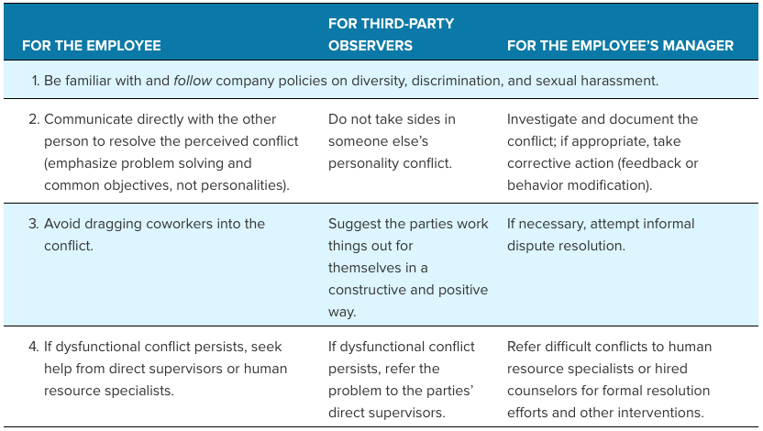
Causes of Conflict
LECTURE 10: Conflict ∙ Conflict Management ∙ Negotiation

Slide 11
Causes of Conflict
While conflict can often begin in a functional way, it can escalate and turn dysfunctional
Escalation is indicated by:
  Use of threatening tactics or ”power plays”
  More issues are brought into the conflict
  Issues move from specific to general
  More people and groups get involved
  Goals shift from ’resolution’ to ‘winning’ or even just harming the other party
LECTURE 10: Conflict ∙ Conflict Management ∙ Negotiation

Slide 12
Experienced Conflict
Perceived and felt conflict define the actual conflict that the parties then attempt to resolve; this definition can be affected by many things:
  The importance of what is affected by the structural or personal factor
  The motives that parties attribute for the others’ actions, the assumptions they’re making
  The existing relationship between the parties (e.g., trusting, critical, power inequalities, etc.)
LECTURE 10: Conflict ∙ Conflict Management ∙ Negotiation

Slide 13
Experienced Conflict
When in a group, members develop shared perceptions of conflict (i.e., conflict states)
Conflict states often reinforce group cognitions and escalate conflict through “in-group” biases:
  In-group members view themselves as unique individuals, yet stereotypes members of other groups
  In-group members see themselves as morally correct, and outsiders as immoral
  Outsiders are viewed as threats
  Differences between other groups are distorted
LECTURE 10: Conflict ∙ Conflict Management ∙ Negotiation
Notes:
In group bias, can extend for a long time – the group keeps it going.
In-group bias sees them selves as being more moral than other
Group differences are exagerated

Slide 14
Conflict Management
The nature of the perceived/felt conflict, along with a person’s or group’s traits, determine the strategies that emerge in their conflict process:
Cooperative strategies
assume win-win is possible, engage in honest communication, trust, and openness to risk/vulnerability
Assertive/Competitive strategies
assume win-lose will happen, dishonest communication, rigid positions
LECTURE 10: Conflict ∙ Conflict Management ∙ Negotiation

Slide 15
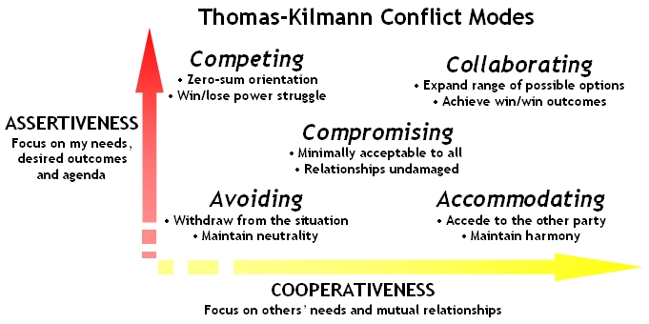
Conflict Management
The two strategies combine and give rise to unique conflict management styles:
LECTURE 10: Conflict ∙ Conflict Management ∙ Negotiation

Slide 16

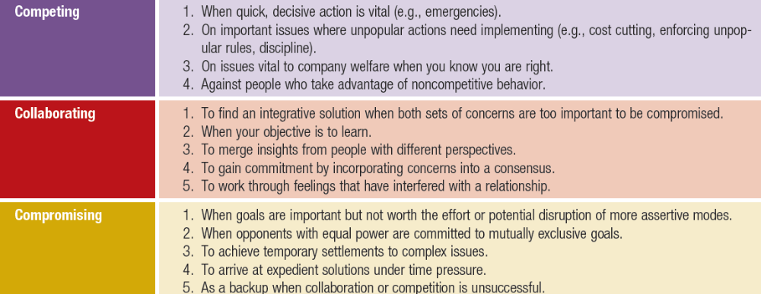
Conflict Management
LECTURE 10: Conflict ∙ Conflict Management ∙ Negotiation

Slide 17
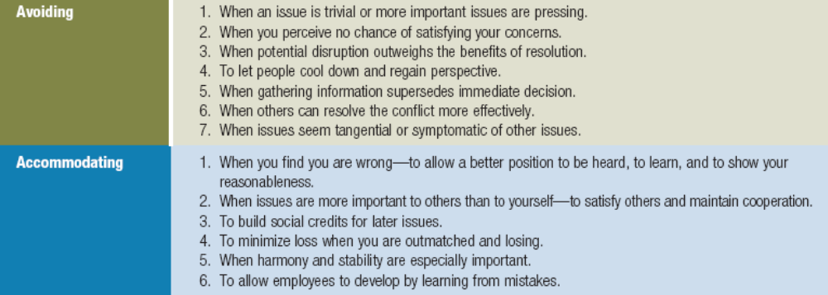
Conflict Management
LECTURE 10: Conflict ∙ Conflict Management ∙ Negotiation

Slide 18
Conflict Management
Ineffective techniques among the styles include:
Nonaction, secrecy, administrative orbiting (delays), due process nonaction (system is too costly), character assassination
Effective techniques include:
Superordinate goals(a common goal), bring in new resources to solve the problem, change personnel, re-structure, finding common ground, allowing parties to safely express frustrations, letting people take the lead in solving problems with which they’re familiar
LECTURE 10: Conflict ∙ Conflict Management ∙ Negotiation

Slide 19
Conflict Management
Simply having people from conflicting groups interact more often isn’t enough to reduce conflict or in-group bias (i.e., the contact hypothesis), specific negative relationships and negative attitudes need to be addressed
Dysfunctional conflict can be prevented by building psychological safety, a shared belief that it is safe to engage in risky behavior, such as questioning practices or ideas, without retribution
LECTURE 10: Conflict ∙ Conflict Management ∙ Negotiation

Slide 20
Conflict Management
Well managed conflict can heighten rational decision-making and reduce groupthink, in contrast, dysfunctional conflict can impair communication, resource-sharing, collaborative input, and performance
LECTURE 10: Conflict ∙ Conflict Management ∙ Negotiation

Slide 21
Negotiation
Negotiations are a specific type of conflict management wherein two or more parties exchange goods or services and attempts to agree on an exchange rate for them
There are two general negotiation strategies:
  Distributive bargaining: Zero-sum conditions, any gain one party makes is a loss to the other, low information sharing, opposed interests
  Integrative bargaining: Broadens goods/services to ensure win-win, high info sharing, congruent interests collaborative
LECTURE 10: Conflict ∙ Conflict Management ∙ Negotiation

Slide 22
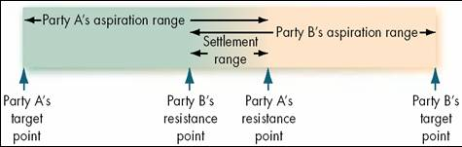
Negotiation
In distributive bargaining, parties compete for power, leveraging offers, deadlines, and politics:
In integrative bargaining, parties focus on long-term relationships, through being open, focusing on underlying goals, and considering alternatives
LECTURE 10: Conflict ∙ Conflict Management ∙ Negotiation

Slide 23
Negotiation Process
is a formal process
There are five steps in negotiation:
  Preparation and planning: Define own goals, anticipate partner’s goals, gather data on similar negotiations, develop strategy, identify least acceptable outcomes (for all parties)
  Definition of ground rules: Set people, issues to cover, place, time allotted – who where when...
  Clarification and justification: Elaborate on positions
  Bargaining and problem-solving: Make concessions
  Closure and implementation: Contract, if needed
LECTURE 10: Conflict ∙ Conflict Management ∙ Negotiation

Slide 24
Negotiation Process
If an impasse is reached, third-parties are used:
Conciliator: Only mediates communication
Arbitrator: Dictates an agreement
Mediator: Rationally facilitates an agreement
LECTURE 10: Conflict ∙ Conflict Management ∙ Negotiation

